Slide 1
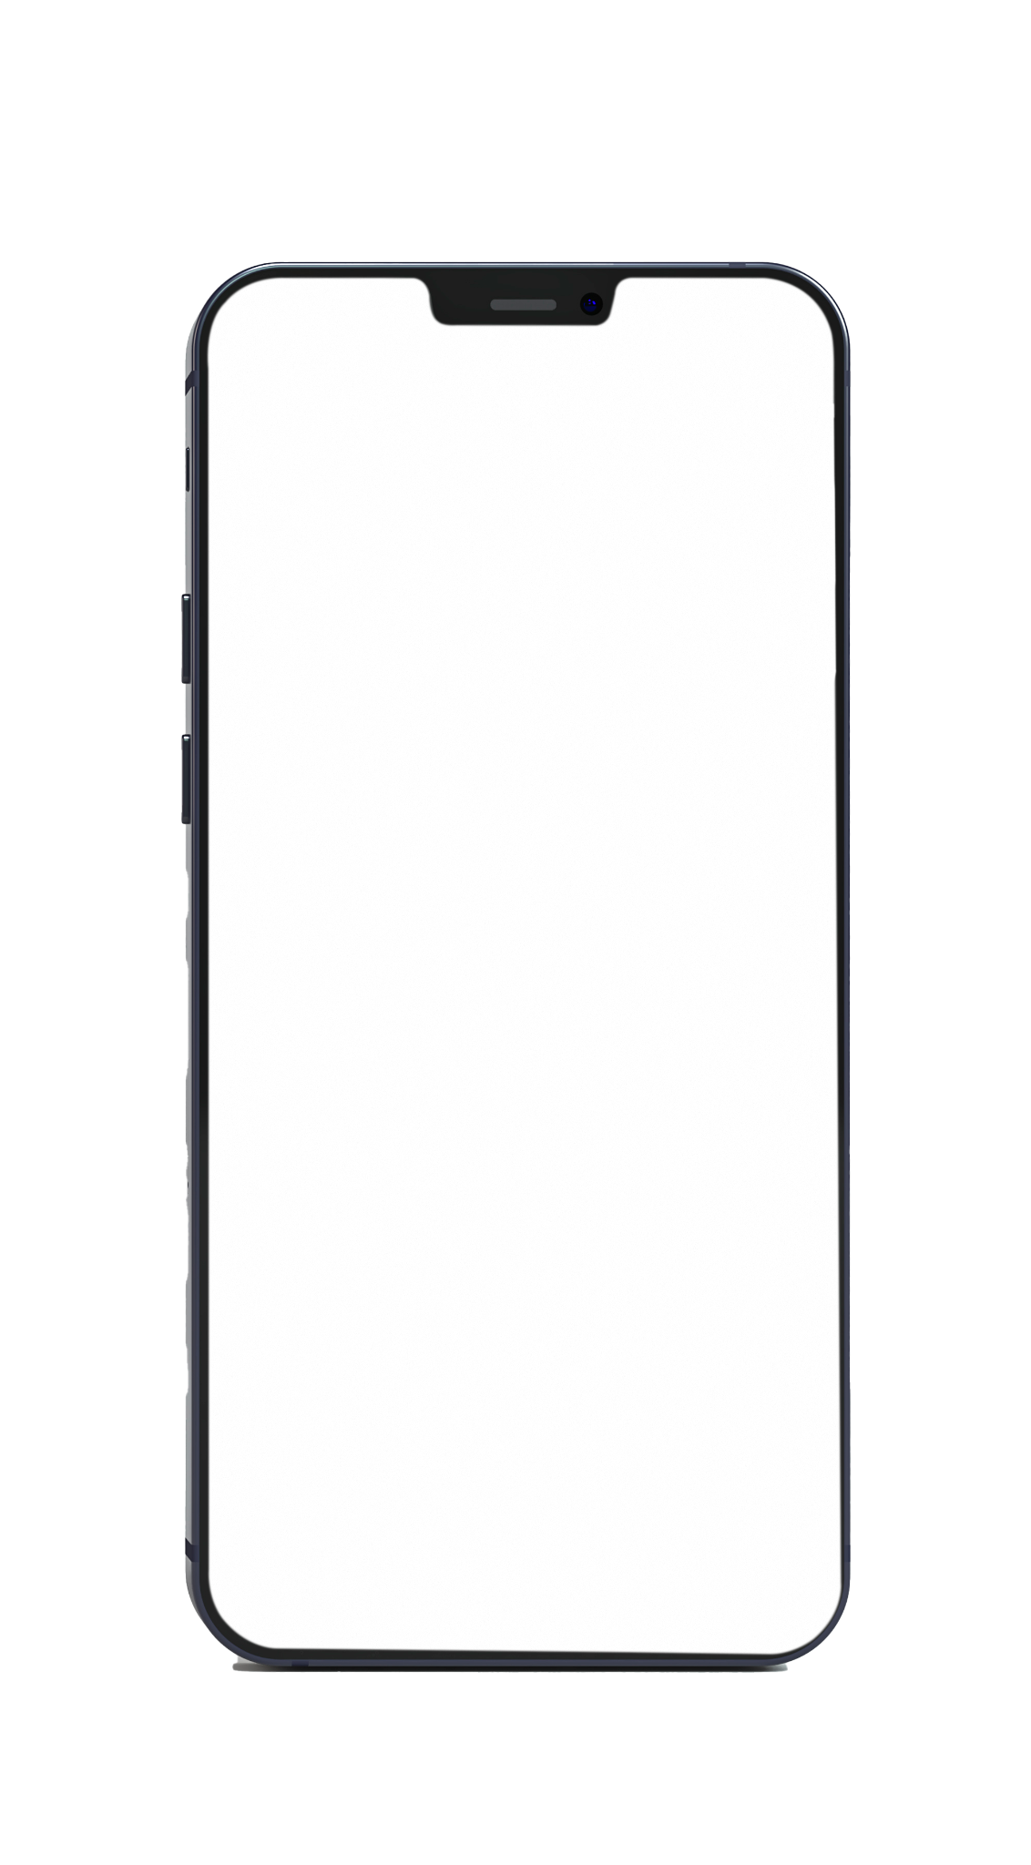

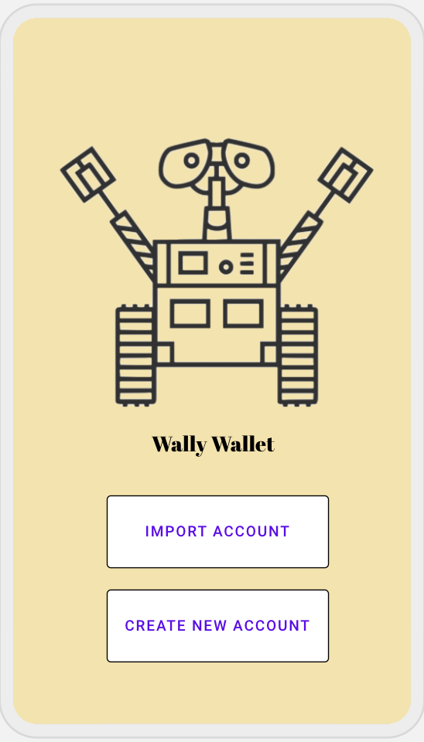


Wally
Save your time in the tedious transaction processes.
Wally Wallet
Wally Wallet

Slide 2
Table of contents
01
02
Wally
— our solution
Wallet Overview
03
04
Demo & Technics
Business Plan

Slide 3
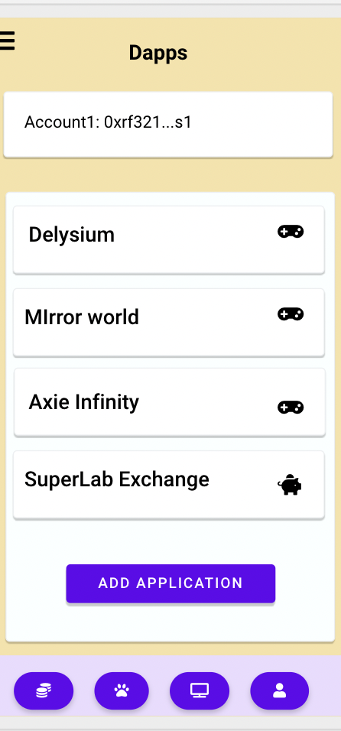
01
Wallet Overview
Wallet is the
Wally Wallet

Slide 4
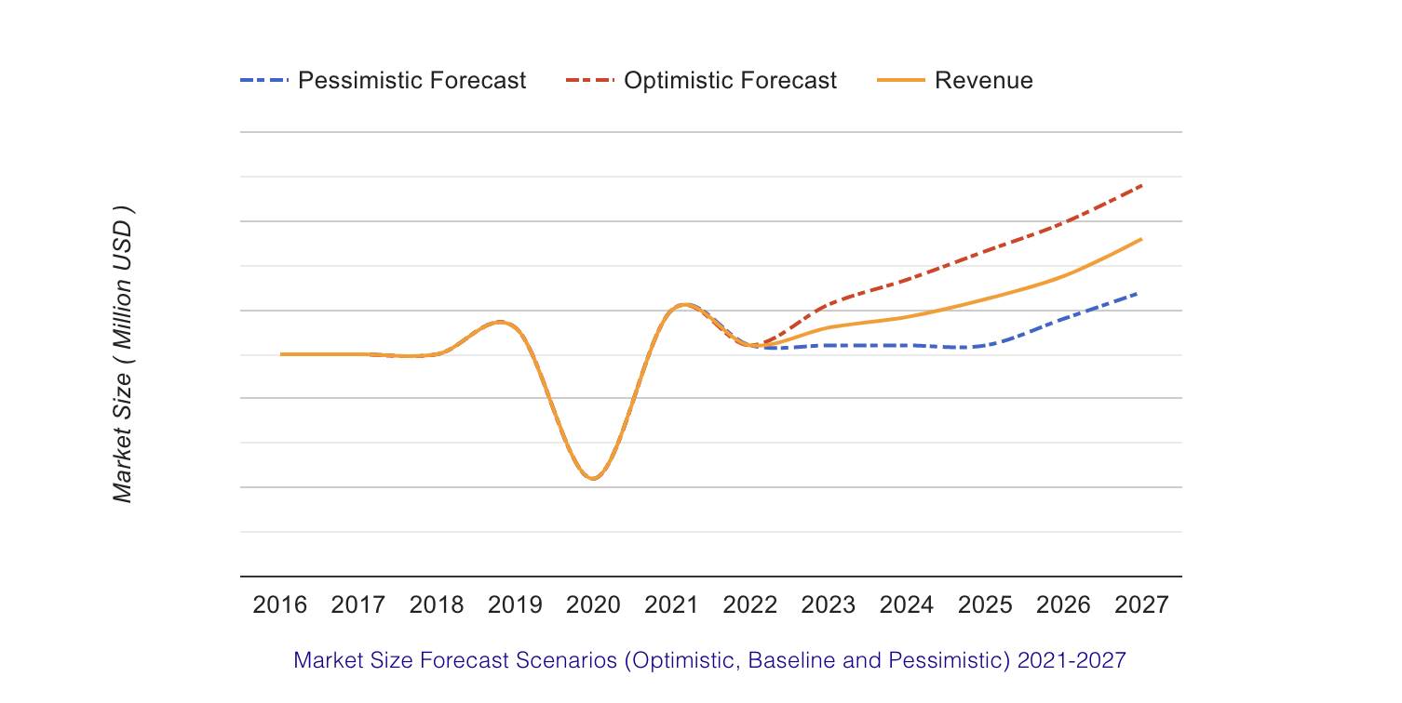


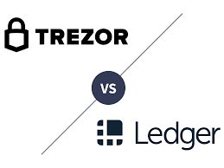

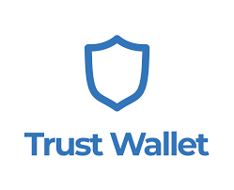
Crypto Wallets Market
Web/Mobie wallet
Hardware wallet
Notes:
Crypto wallets market is expected to grow at a CAGR of 29.5% during the forecast period of 2021-2031.
Skyrocketing demand for cryptocurrencies is one of the major factors driving the growth of the Global Crypto Wallet Market. The market growth is anticipated to be driven by advancement in the technology across the cryptocurrency market. Likewise, a speedy surge in the investments in cryptocurrency-based devices is estimated to drive the crypto wallets market growth in near future.

Slide 5
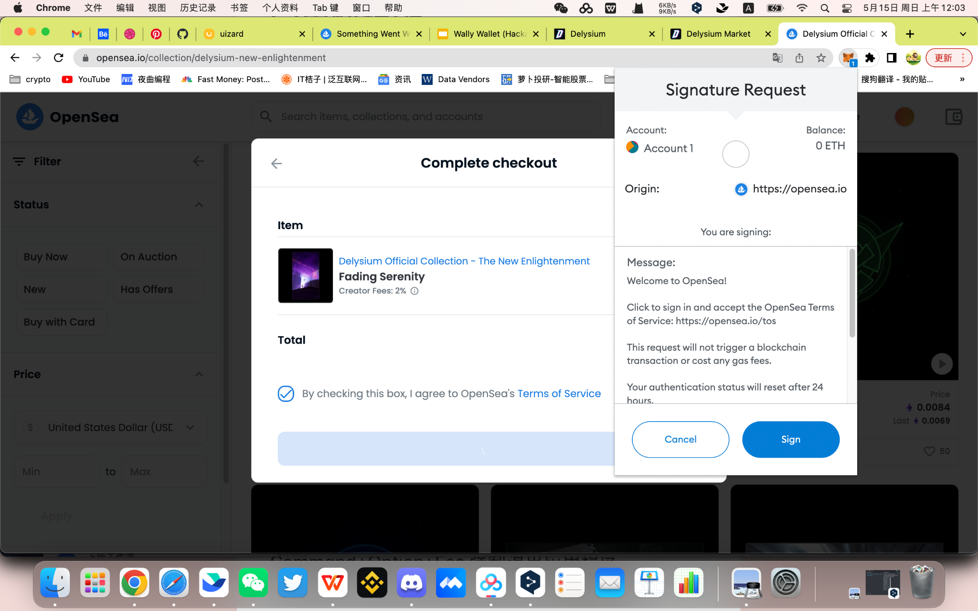
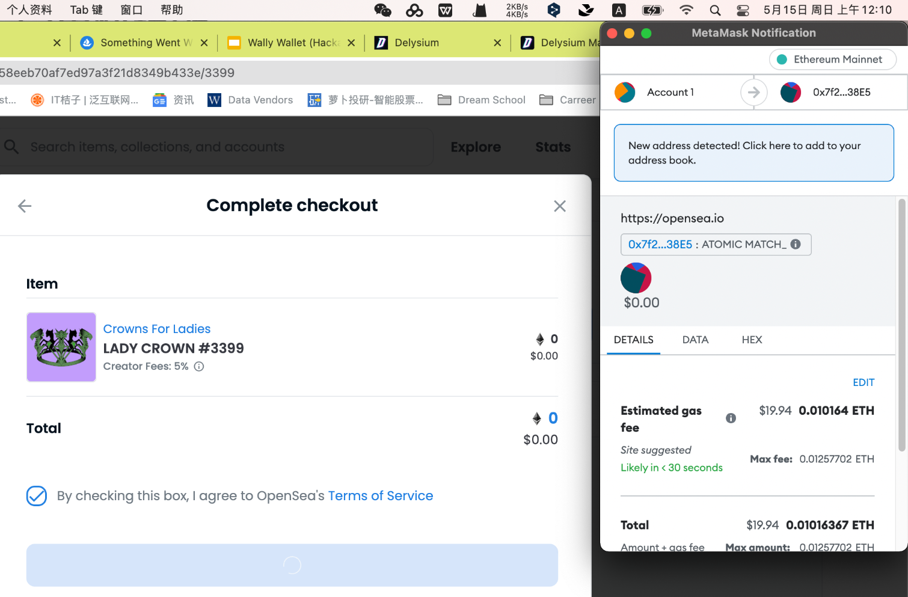



Current Problem:
Centralized wallet
Decentralized wallet
not fully own by users
Notes:
Decentralized web wallet are troublesome for users, they need to accept every transaction even from known apps, or worse approve the app to spend x amount of money on smart-contract and paying additional gaz fees.
Centralized wallet are not fully own by users

Slide 6
02
Wally Wallet
“Save your time in the tedious transactions.”
— our solution

Slide 7
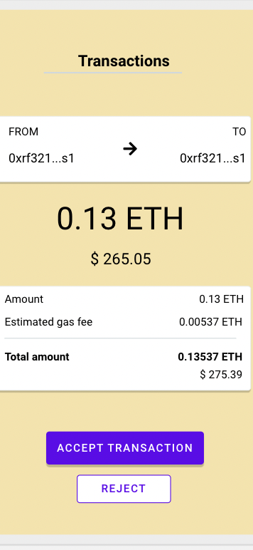
Solutions
Kevin want to buy something with USDC on the Dapp
Core idea:
Change the way you accept transactions.
If this dapp is authorised
to spend USDC？
NO！
YES！
A popup will show up on your mobile to ask you if you accept the transaction
The transaction will be send automatically without disturbing the user.

Slide 8
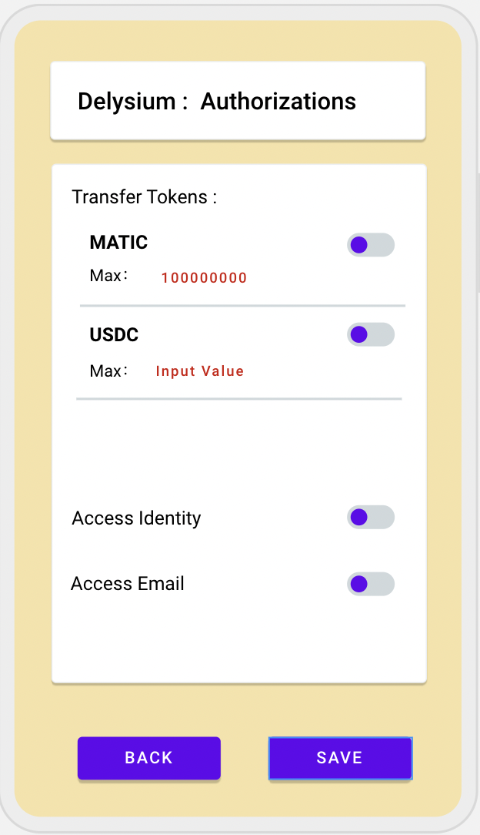
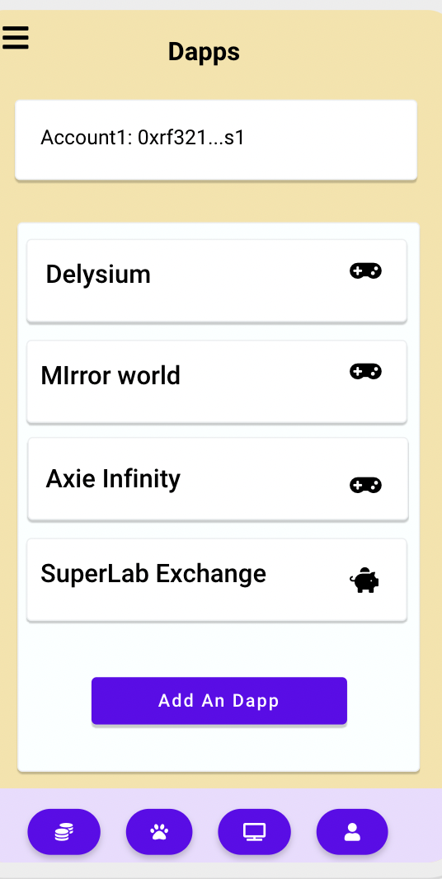
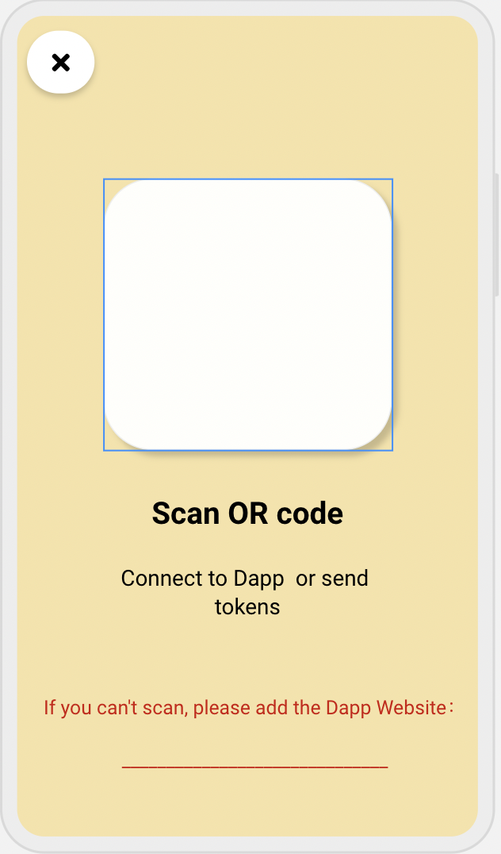
User Flow
Turn on the Wally Wallet and click the button “Add An Dapp” on the “Dapps” page.
Use Wally Wallet to scan the Dapp QR code or Type in the Dapp URL.
User login on the dapp page
Step 1
Step 3
Step 2
Done!!! No more worrying about being constantly interrupted!
Click on the dapp button you want to interact with and set your authorisation information. Access or reject the transaction
(can be changed later in settings)
Step 4
Notes:
This dapp will then appear in your wallet. Click on the dapp button you want to interact with and set your authorisation information, including token type, a daily spent limit for each authorized tokens for specific dapp, etc. so dapp can request automatic sign transaction for specific tokens or contracts (which are already registered and checked by our sass), so the dapp can make the User Experience free-of-blocks for its own tokens for example.
Now, No more worrying about being constantly interrupted and asked if you want to confirm a transaction!

Slide 9
Core Idea
Benefits
User friendly.
Great for game interaction!!!!
Change the way you accept transactions.
By giving authorizations to dapps to do things at a upper level, removing the need to use 'approve' function in the smart contracts and the 'manual accept transaction' for everything you do on web3.
The app can :
sign transaction and publish it
manage dapp access
automatically sign OR manual sign with popup
receive push-notification for each transaction
Notes:
User friendly: Non-web app and games can integrate this wallet easily with a restfull api and it still decentralized wallet
Great for game interaction!!!!: For some specific dapps/games you can authorize full access over that game assets, so the game can be played without any interruption.

Slide 10
Problem & Hack security
Problem:
compatibility with existing dapps
require permanent connection on user phone
Hack security:
We could ask the user when he is playing game or using dapps, to avoid hack of third parties to be succesfull. for example, when user start a game, the game notify his mobile phone and so he can say if its him or not who he's playing. we can leverage many similar securities on the middle between app and user

Slide 11
03
Demo &
Technics
Wally Wallet

Slide 12
Demo
Demo
https://app.uizard.io/prototypes/0ovpzwMYnEiJgedvXPgw/player

Slide 13
Demo
Technical Process
- game backend authorize itself to the api
- player craft an item in a game
- game backend call api with the action to do(contract address, method, params)
- api verify access, create and send transaction to mobile with push-notification
- mobile app verify again transaction with local access
- mobile sign and publish transaction
- mobile call api when transaction is done
- api validate transaction and send notification to the client (game)
- game can update the item

Slide 14
Demo
Transaction flow
app call api with smart-contract address, methods name, and array of parameters
api create the transaction by looking into ABI (previously uploaded) for that contract address and then send that to the mobile app
mobile app sign it, and process it to the blockchain

Slide 15
04
Business
Plan
Wally Wallet

Slide 16
Business Plan
Users
Dapps
enterprise pay to integrate their app
Free for Users
Notes:
free for user
enterprise pay to integrate their app
it can also be used to store personal or other profile informations locally on phone. and if given dapp access, the dapp can read it trough a bridge between dapp > sass > mobile app > sass > dapp. sass do not store any information (maybe can encrypt during the transfer)

Slide 17
“Save your time in the tedious transactions.”

Slide 18
—Wally Wallet
“Thank you!”

